Slide 1
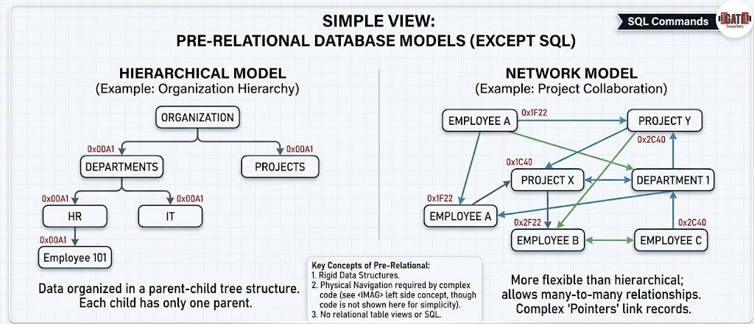
The Origin of SQL: Solving the Data Mess
Before SQL, databases in the 1960s and early 1970s relied on hierarchical or network models (like IBM's IMS). Data was stored in rigid tree structures where everything was linked by physical pointers.
To find a specific piece of information, programmers had to write complex, low-level procedural code to manually navigate the exact physical path where the data lived on the disk. If the database structure changed even slightly, the applications using it would break, requiring the code to be completely rewritten.

Slide 2
SQL was developed in the early 1970s by IBM researchers
Donald D. Chamberlin and
Raymond F. Boyce,
which organized data into clean tables instead of rigid, interconnected pointer networks.
It was specifically created to shift database management from complex, low-level procedural programming into a
human-readable,
declarative
English-like language (SELECT, INSERT, WHERE)
that allowed both developers and business professionals to easily query, secure, and manipulate data without needing to know its physical location on a disk.

Slide 3
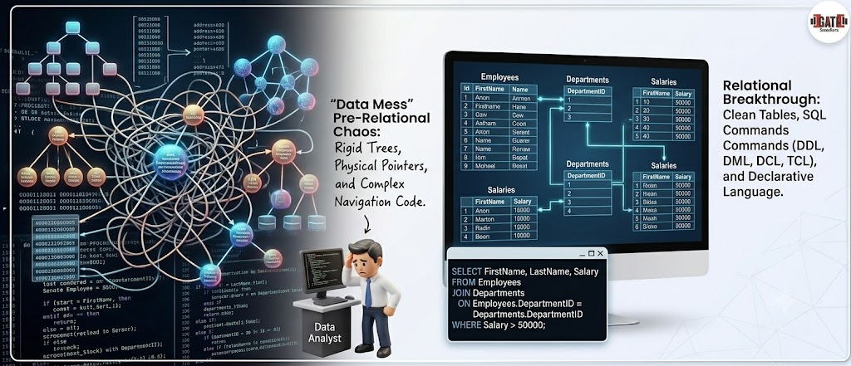

Slide 4
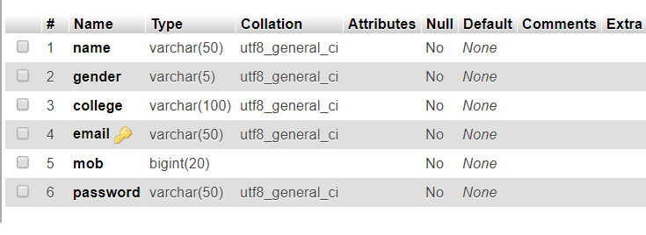
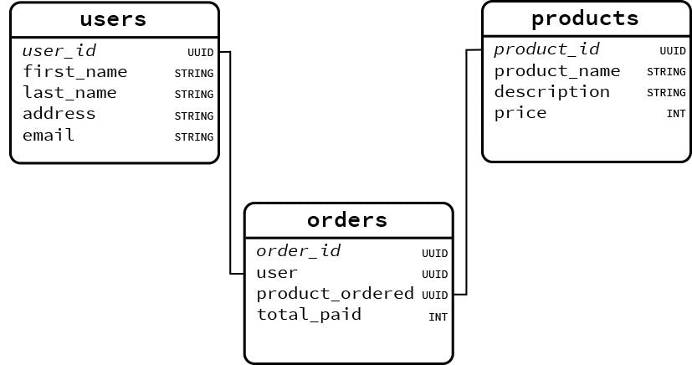
SQL Table Structure
SQL Relational Table Structure

Slide 5
CREATE TABLE Cust1 (
CustID INT PRIMARY KEY,
FirstName VARCHAR(50),
Country VARCHAR(50)
);
-- Inserting the data into the table
INSERT INTO Customers (CustomerID, FirstName, Email, Country) VALUES
(1, 'Alice', 'USA'),
(2, 'Bob', 'UK'),
(3, 'Charlie','Canada');

Slide 6
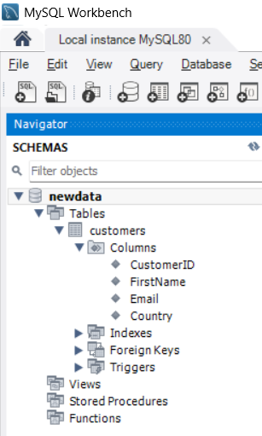
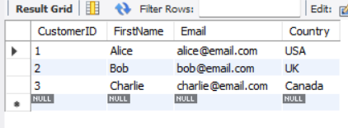
Databases: An organized digital container used to store, manage, and secure large amounts of structured data.
Tables: A structured grid within a database made up of vertical columns and horizontal rows used to group related information together.
Rows and Columns: The core building blocks of a table, where columns define the specific data categories (attributes) and rows contain the individual records (entries).

Slide 7
String
Char
char(50) string(0-255)
Varchar varchar(50) string(0-255)
BLOB
BLOB(1000) string(0-65535)
Integer
INT
-2,147,483,648 to 2,147,483,647
TINYINT
-128 to 127
BIGINT
-9,223,372,036,854,775,808 to 9,223,372,036,854,775,807
BIT
1 to 64
BIT(2)
Decimal (Integer)
FLOAT
23 digits
Double
(24 to 53 digits)
Date
DATE
YYYY-MM-DD
1000-01-01 to 9999-12-31
Year
4 digit
From 1901 to 2155
TIME
HH:MM:SS
-838:59:59 to 838:59:59
Time
TIME
HH:MM:SS
-838:59:59 to 838:59:59
DATETIME
YYYY-MM-DD HH:MM:SS
1000-01-01 00:00:00 to 9999-12-31 23:59:59
Date Time

Slide 8
DQL (Data Query Language)
Used to fetch or retrieve data from the database.
DML (Data Manipulation Language)
Used to modify the data stored within existing database objects.
DDL (Data Definition Language)
Used to define, alter, or safely destroy the structure of database objects like tables, indexes, and schemas.
DCL (Data Control Language)
Used to manage permissions and access control for database users.
TCL (Transaction Control Language)
Used to manage transactions, ensuring data integrity and consistency during multi-step DML operations.

Slide 9
DQL
SELECT
Retrieves data
DDL
CREATE
ALTER
DROP
TRUNCATE
Creates a new database
Deletes an entire database object
Removes all records from a table
ADD
Modify
Drop
Add Column
Modify size of the Column
Drops the Column
DML
INSERT
UPDATE
DELETE
Adds new rows
Modifies existing data within a table
Removes rows from a table.

Slide 10
DCL
GRANT
REVOKE
Gives a user access privileges to the database
Withdraws access privileges previously given
TCL
COMMIT
ROLLBACK
SAVEPOINT
Saves all changes made during the current transaction permanently
Undoes changes made during the current transaction if an error occurs
Sets a point within a transaction to which you can roll back later

Slide 11
Comparison Operators:
= Equal to
<> Not equal to
!= Not equal to
< Less than
> Greater than
<= Less than or equal to
>= Greater than or equal to
Logical Operators:
AND Logical AND
OR Logical OR
NOT Logical NOT
Membership Operators:
IN Checks if a value exists in a set of values
NOT IN Checks if a value does not exist in a set of values
Operators

Slide 13
Between Operator:
BETWEEN Checks if a value lies within a specified range
Not BETWEEN Checks if a value lies within a specified range
LIKE Operator(WILDCARD):
LIKE Matches patterns in strings using wildcard characters % and _
IS NULL Operator:
IS NULL Checks if a value is NULL
IS NOT NULL Checks if a value is not NULL
EXISTS Operator:
EXISTS Checks if a subquery returns any rows
NOT EXISTS Opposite of Exists

